Slide 1
CSE 220
Jannatun Noor
Jannatun.noor@bracu.ac.bd
Lecture Made by: Aminul Huq

Slide 2
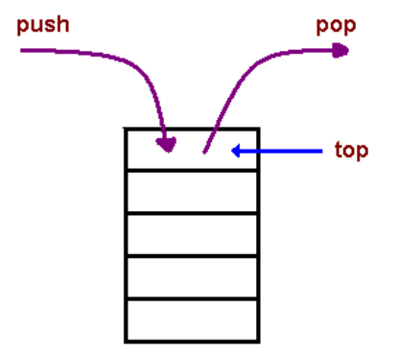
Stack
A Stack is a restricted ordered sequence in which we can only add to and remove from one end — the top of the stack.
Imagine stacking a set of books on top of each other — you can push a new book on top of the stack, and you can pop the book that is currently on the top of the stack.
The only book that can be taken out of the stack is the most recently added one; a stack is thus a "last in, first out" (LIFO) data structure.

Slide 3
Operations
Three basic stack operations are:
push(obj): adds obj to the top of the stack ("overflow" error if the stack has fixed capacity, and is full)
pop: removes and returns the item from the top of the stack ("underflow" error if the stack is empty)
peek: returns the item that is on the top of the stack, but does not remove it ("underflow" error if the stack is empty)

Slide 4
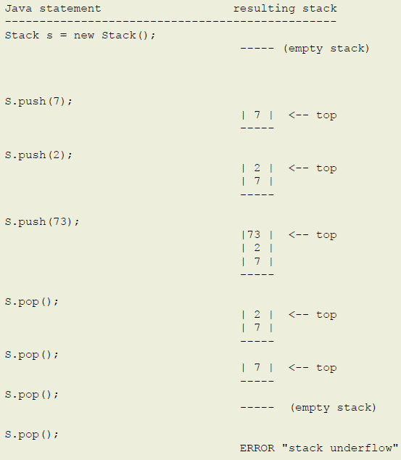

Slide 5
Stack applications
Reverse: The simplest application of a stack is to reverse a word. You push a given word to stack – letter by letter – and then pop letters from the stack.
Undo: Another application is an "undo" mechanism in text editors; this operation is accomplished by keeping all text changes in a stack. Popping the stack is equivalent to "undoing" the last action.
Expression evaluation: When an arithmetic expression is presented in the postfix form, you can use a stack to evaluate it to get the final value. For example: the expression 3 + 5 * 9 (which is in the usual infix form) can be written as 3 5 9 * + in the postfix. More interestingly, postfix form removes all parentheses and thus all implicit precedence rules; for example, the infix expression ((3 + 2) * 4) / (5 - 1) is written as the postfix 3 2 + 4 * 5 1 - /. You can now design a calculator for expressions in postfix form using a stack.

Slide 6
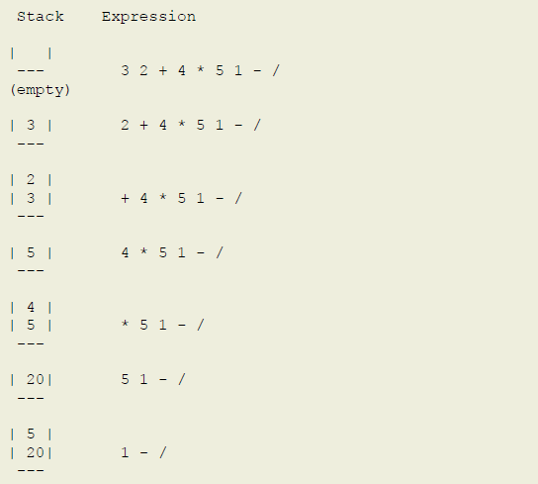

Slide 7
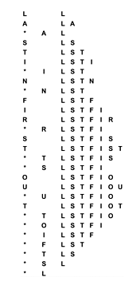
1. A letter means push and an asterisk means pop in the sequence
E A S * Y * Q U E * * * S T * * * I O * N * * *.
Give the sequence of values returned by the pop operations.

Slide 8
Equation evaluation
we shall see, any arithmetic expression can be arranged in this form, which is called postfix, by contrast with infix, the customary way of writing arithmetic expressions.
5 9 8 + 4 6 * * 7 + * - Postfix
5 * ( ( (9 + 8) * (4 * 6) ) + 7) – Infix
The reverse of postfix is called prefix, or Polish notation

Slide 9
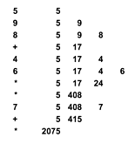
Evaluation of a postfix expression
This sequence shows the use of a stack to evaluate the postfix expression 5 9 8 + 4 6 * * 7 + *. Proceeding from left to right through the expression, if we encounter a number, we push it on the stack; and if we encounter an operator, we push the result of applying the operator to the top two numbers on the stack.

Slide 10
Conversion of an infix expression to postfix
This sequence shows the use of a stack to convert the infix expression (5 * ( ( (9 + 8) * (4 * 6) ) + 7) ) to its postfix form 5 9 8 + 4 6 * * 7 + *. We proceed from left to right through the expression: If we encounter a number, we write it to the output; if we encounter a left parenthesis, we ignore it; if we encounter an operator, we push it on the stack; and if we encounter a right parenthesis, we write the operator at the top of the stack to the output.

Slide 11
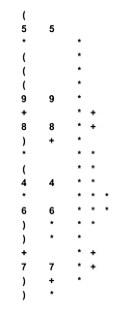
Convert to postfix expression from the following expression
( 5 * ( ( 9 * 8 ) + ( 7 * ( 4 + 6 ) ) ) )

Slide 12
Queue
Rather than removing the most recently inserted element, we remove the element that has been in the queue the longest.
The first-in, first-out (FIFO) queue is similar to the pushdown stack but uses the opposite rule to decide which element to remove for remove
People moving on an escalator. The people who got on the escalator first will be the first one to step out of it.
People standing outside the ticketing window of a cinema hall. The first person in the line will get the ticket first and thus will be the first one to move out of it.
The elements in a queue are added at one end called the REAR and removed from the other end called the FRONT.

Slide 13
FIFO queue example
This list shows the result of the sequence of operations in the left column (top to bottom), where a letter denotes put and an asterisk denotes get. Each line displays the operation, the letter returned for get operations, and the contents of the queue in order from least recently inserted to most recently inserted, left to right.

Slide 14
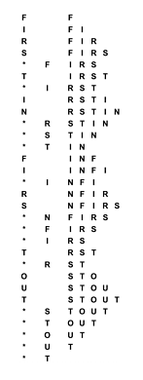
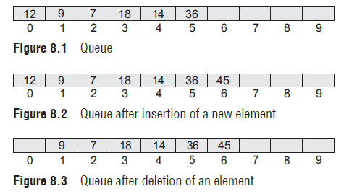
1. A letter means put/push and an asterisk means get/pop in the sequence
E A S * Y * Q U E * * * S T * * * I O * N * * *.
Give the sequence of values returned by the get operations when this sequence of operations is performed on an initially empty FIFO queue.

Slide 15
Overflow & Underflow
before inserting an element in a queue, we must check for overflow conditions. An overflow will occur when we try to insert an element into a queue that is already full. When REAR = MAX – 1, where MAX is the size of the queue, we have an overflow condition.
before deleting an element from a queue, we must check for underflow conditions. An underflow condition occurs when we try to delete an element from a queue that is already empty. If FRONT = –1 and REAR = –1, it means there is no element in the queue.

Slide 16
Types of Queue
A queue data structure can be classified into the following types:
1. Circular Queue
2. Deque
3. Priority Queue
4. Multiple Queue

Slide 17

Circular Queue
FRONT = 2 and REAR = 9.
Suppose we want to insert a new element in the queue shown in Fig. Even though there is space available, the overflow condition still exists because the condition rear = MAX – 1 still holds true. This is a major drawback of a linear queue.

Slide 18
Insertion
For insertion, we now have to check for the following three conditions:
If front = 0 and rear = MAX – 1, then the circular queue is full. Look at the queue given in Fig. 8.16 which illustrates this point.
If rear != MAX – 1, then rear will be incremented and the value will be inserted as illustrated in Fig. 8.17.
If front != 0 and rear = MAX – 1, then it means that the queue is not full. So, set rear = 0 and insert the new element there, as shown in Fig. 8.18.

Slide 19
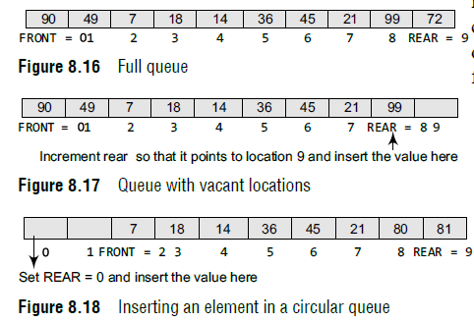

Slide 20
Deletion
To delete an element, again we check for three conditions.
Look at Fig. 8.20. If front = –1, then there are no elements in the queue. So, an underflow condition will be reported.
If the queue is not empty and front = rear, then after deleting the element at the front the queue becomes empty and so front and rear are set to –1. This is illustrated in Fig. 8.21.
If the queue is not empty and front = MAX–1, then after deleting the element at the front, front is set to 0. This is shown in Fig. 8.22.

Slide 21
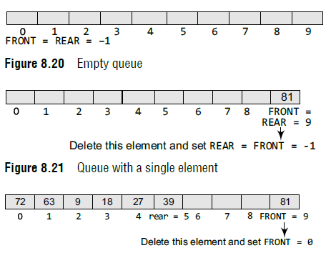

Slide 22
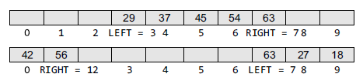
Deques
A deque (pronounced as ‘deck’ or ‘dequeue’) is a list in which the elements can be inserted or deleted at either end.
no element can be added and deleted from the middle.
In a deque, two pointers are maintained, LEFT and RIGHT, which point to either end of the deque. The elements in a deque extend from the LEFT end to the RIGHT end and since it is circular, Dequeue[N–1] is followed by Dequeue[0].

Slide 23
Deque
There are two variants of a double-ended queue. They include
Input restricted deque In this dequeue, insertions can be done only at one of the ends, while deletions can be done from both ends.
Output restricted deque In this dequeue, deletions can be done only at one of the ends, while insertions can be done on both ends.

Slide 24
Multiple Queues
When we implement a queue using an array, the size of the array must be known in advance. If the queue is allocated less space, then frequent overflow conditions will be encountered. To deal with this problem, the code will have to be modified to reallocate more space for the array.
In case we allocate a large amount of space for the queue, it will result in sheer wastage of the memory. Thus, there lies a tradeoff between the frequency of overflows and the space allocated.
So a better solution to deal with this problem is to have multiple queues or to have more than one queue in the same array of sufficient size.

Slide 25
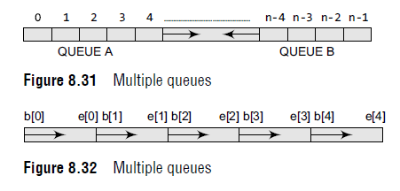
Multiple Queues
In the figure, an array Queue[n] is used to represent two queues, Queue A and Queue B. The value of n is such that the combined size of both the queues will never exceed n.
While operating on these queues, it is important to note one thing—queue A will grow from left to right, whereas queue B will grow from right to left at the same time.

Slide 26
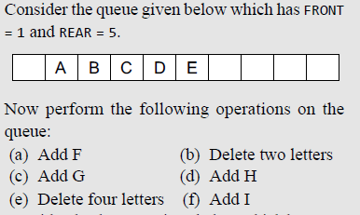
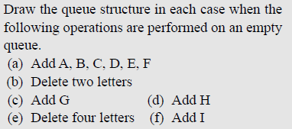
Practice

